Slide 1


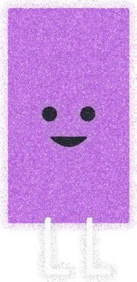







Number Systems Ç
Digital Data Representation
Digital Forensics · Unit 1 · Session 1 of 4 · 2 Hours
Mr. Sarang Rajvansh | Assistant Professor
School of Cyber Security & Digital Forensics
National Forensic Sciences University, Gujarat Campus, Gandhinagar · sarang.rajvansh@nfsu.edu.in

Slide 2







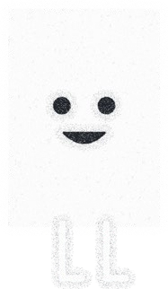



Hello!
I am Sarang Rajvansh
Assistant Professor,
School of Cyber Security & Digital Forensics,
National Forensic Sciences University, Gujarat Campus, Gandhinagar.
You can find me at sarang.rajvansh@nfsu.edu.in

Slide 3


Today's Agenda
Presenter Notes
2026-08-24 17:39:20
--------------------------------------------
Timing guide: number systems 25 min, conversions 30 min, binary operations 25 min, endianness 15 min, encodings 20 min, recap 5 min.
→ Number systems: binary, octal, decimal, hexadecimal
→ Conversions between number systems, with solved examples
→ Operations on binary numbers: addition, subtraction,
complements,
multiplication, division
→ Byte ordering: little-endian and big-endian formats
→ Character encoding: ASCII and Unicode (UTF-8, UTF-16, UTF-32)
→ Practice tasks and a recap at the end of every section

Slide 4


Why This Session Matters in Forensics
Presenter Notes
2026-08-24 17:39:21
--------------------------------------------
Motivate with a WinHex screenshot on the projector if available. Ask who has opened a file in a hex editor before.
→ Every artefact you will ever examine (a disk image, a memory dump, a packet capture) is ultimately just bits and bytes.
→ Hex editors such as WinHex, HxD and FTK Imager show evidence as raw hexadecimal: you must read it fluently.
→ File signatures, hash values, IP and MAC addresses, timestamps and partition tables are all written in binary or hex.
→ Interpreting a value wrongly (wrong base, wrong byte order, wrong encoding) can silently corrupt an entire finding.
→ Forensic angle: an examiner who can decode raw bytes by hand can verify what the tools claim, and defend it in court.

Slide 5



Bits, Nibbles, Bytes and Words
→ A bit (binary digit) is the smallest unit of digital data: a single 0 or 1, physically a voltage, a charge or a magnetic state.
→ A nibble is a group of 4 bits: exactly one hexadecimal digit.
→ A byte is a group of 8 bits: the smallest addressable unit of memory. One byte holds one of 256 values (0 to 255).
→ A word is the natural data size of a processor: 32 bits or 64 bits on modern CPUs.
This is why we speak of 32-bit and 64-bit operating systems.
→ Forensic angle: hex editors display evidence one byte at a time, as two hex digits (two nibbles).

Slide 6
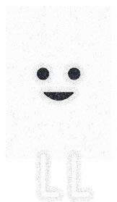

Units of Digital Storage
Presenter Notes
2026-08-24 17:39:23
--------------------------------------------
Drive makers use decimal units, operating systems mostly binary units. A "500 GB" drive shows about 465.7 GB in Windows because Windows actually counts GiB.
Unit | Decimal (SI) | Unit | Binary (IEC)
1 kilobyte (KB) | 1,000 bytes | 1 kibibyte (KiB) | 1,024 bytes
1 megabyte (MB) | 1,000² bytes | 1 mebibyte (MiB) | 1,024² bytes
1 gigabyte (GB) | 1,000³ bytes | 1 gibibyte (GiB) | 1,024³ bytes
1 terabyte (TB) | 1,000⁴ bytes | 1 tebibyte (TiB) | 1,024⁴ bytes

Slide 7

Why "500 GB" Shows as 465 GB
→ Storage vendors count in decimal units; Windows reports sizes in binary units while still labelling them KB, MB, GB.
→ A "500 GB" drive = 500,000,000,000 bytes = about 465.7 GiB, which Windows displays as "465 GB": nothing is missing.
→ Forensic angle: always record media size in exact bytes and total sectors in your notes, never in rounded GB.

Slide 8
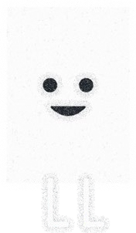


What is a Number System?
→ A number system is a method to represent (write) numbers.
→ Every number system has a set of unique symbols, called its digits or literals.
→ The count of these symbols is the radix or base of the number system.
→ These are positional number systems: the value of each digit depends upon its position within the number.
→ Example: in 555, the same digit 5 is worth 500, 50 and 5 depending on where it stands.
→ Notation: the base is written as a subscript, e.g. (101)₂, (75)₈, (240)₁₀, (F0)₁₆.

Slide 9
The Four Number Systems of Computing
Number system | Base | Digits used | Example | Where you meet it
Binary | 2 | 0, 1 | (11110000)₂ | raw data, machine level
Octal | 8 | 0 - 7 | (360)₈ | Unix / Linux permissions
Decimal | 10 | 0 - 9 | (240)₁₀ | human counting
Hexadecimal | 16 | 0 - 9, A - F | (F0)₁₆ | hex editors, hashes, MAC

Slide 10

Binary Number System (Base 2)
→ Uses only two digits: 0 and 1. The base is 2 because there are only two symbols.
→ Hardware loves binary: a transistor is on or off, a capacitor charged or empty, a magnetic domain north or south.
→ Each position is a power of 2: ... 2⁴ 2³ 2² 2¹ 2⁰, that is ... 16, 8, 4, 2, 1.
→ Example: (1101)₂ = 8 + 4 + 0 + 1 = (13)₁₀.
→ The leftmost bit is the MSB (most significant bit), the rightmost bit is the LSB
(least significant bit).

Slide 11

Octal Number System (Base 8)
Presenter Notes
2026-08-24 17:39:28
--------------------------------------------
Quick check: why can 743924 never be an octal number? Because 9 is not an octal digit.
→ Uses eight digits: 0 to 7. Digits 8 and 9 do not exist in octal.
→ Each position is a power of 8: ... 8² 8¹ 8⁰, that is ... 64, 8, 1.
→ One octal digit represents exactly three binary bits, which made octal popular on early computers.
→ Example: (17)₈ = 1 × 8 + 7 = (15)₁₀.
→ Forensic angle: Linux file permissions are octal: chmod 755 means rwx r-x r-x,
i.e. 111 101 101 in binary.

Slide 12

Decimal Number System (Base 10)
→ The system humans use daily: ten digits, 0 to 9, base 10.
→ Each position is a power of 10: ... 10² 10¹ 10⁰, that is ... 100, 10, 1.
→ Example: (240)₁₀ = 2 × 100 + 4 × 10 + 0 × 1.
→ Computers do not store decimal internally; they convert decimal input into binary, work in binary, and convert back for display.
→ That is why conversion skills are the bridge between what people write and what machines store.

Slide 13
Hexadecimal Number System (Base 16)
→ Uses sixteen symbols: 0 to 9 and the letters A to F, where A = 10, B = 11, C = 12, D = 13, E = 14, F = 15.
→ Each position is a power of 16: ... 16² 16¹ 16⁰, that is ... 256, 16, 1.
→ One hex digit represents exactly four binary bits (one nibble), so one byte = two hex digits.
→ Hex is the standard shorthand for binary: (1111 0000)₂ is simply written F0.
→ Example: (2D5)₁₆ = 2 × 256 + 13 × 16 + 5 × 1 = (725)₁₀.

Slide 14
Master Table: 0 to 15 in Every Base
Presenter Notes
2026-08-24 17:39:31
--------------------------------------------
Students should memorise this table, especially binary to hex. It is the single most used table in disk forensics.
Decimal | Binary | Octal | Hex | Decimal | Binary | Octal | Hex
0 | 0000 | 0 | 0 | 8 | 1000 | 10 | 8
1 | 0001 | 1 | 1 | 9 | 1001 | 11 | 9
2 | 0010 | 2 | 2 | 10 | 1010 | 12 | A
3 | 0011 | 3 | 3 | 11 | 1011 | 13 | B
4 | 0100 | 4 | 4 | 12 | 1100 | 14 | C
5 | 0101 | 5 | 5 | 13 | 1101 | 15 | D
6 | 0110 | 6 | 6 | 14 | 1110 | 16 | E
7 | 0111 | 7 | 7 | 15 | 1111 | 17 | F

Slide 15


Hexadecimal in the Wild
Presenter Notes
2026-08-24 17:39:33
--------------------------------------------
Demo idea: rename a .jpg to .docx and show the FF D8 FF signature surviving in a hex editor.
→ File signatures (magic numbers), the true identity of a file regardless of its extension:
JPEG: FF D8 FF PNG: 89 50 4E 47 PDF: 25 50 44 46 (%PDF)
Windows EXE: 4D 5A (MZ) ZIP / DOCX / APK: 50 4B 03 04 (PK)
→ Hash values: MD5 = 32 hex digits (128 bits), SHA-1 = 40, SHA-256 = 64.
→ MAC addresses (A4:5E:60:D2:11:0F) and IPv6 addresses are written in hex.
→ Memory addresses and offsets in every forensic tool are hex: offset 0x1BE, address 0x7FF6...
→ Forensic angle: signature mismatch versus extension is a classic sign of evidence hiding.

Slide 16
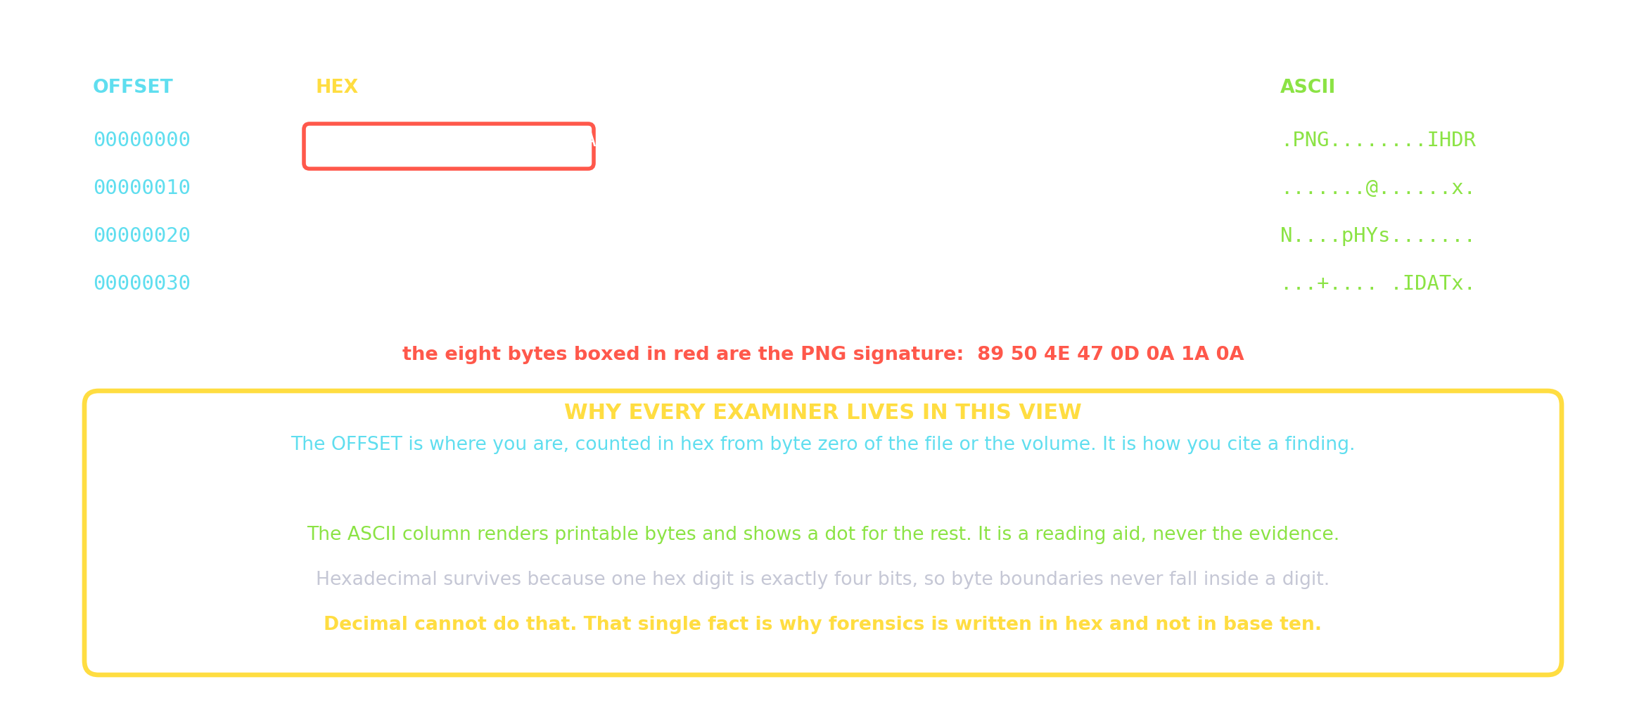
Reading a Hex Dump
Presenter Notes
2026-08-24 17:39:33
--------------------------------------------
Spend time on the last two lines of the yellow panel. One hex digit is exactly four bits, so a byte is always exactly two digits and a boundary never falls inside a digit. Decimal cannot do that: 255 is three digits and 256 is three digits, and neither aligns with anything. That is the whole reason forensics is written in hex.
Offset, hex, ASCII, and why the profession writes in base sixteen.

Slide 17
Powers of Two Worth Memorising
Presenter Notes
2026-08-24 17:39:34
--------------------------------------------
512 = classic sector size, 4096 = modern sector and cluster size, 2^32 = 4 GiB limit of 32-bit systems and FAT32 file size limit.
Power | Value | Power | Value | Power | Value
2⁰ | 1 | 2⁶ | 64 | 2¹² | 4,096
2¹ | 2 | 2⁷ | 128 | 2¹⁶ | 65,536
2² | 4 | 2⁸ | 256 | 2²⁰ | 1,048,576 (1 Mi)
2³ | 8 | 2⁹ | 512 | 2³⁰ | 1,073,741,824 (1 Gi)
2⁴ | 16 | 2¹⁰ | 1,024 (1 Ki) | 2³² | 4,294,967,296
2⁵ | 32 | 2¹¹ | 2,048 | 2⁶⁴ | ≈ 1.8 × 10¹⁹

Slide 18

02
PART 2 OF 5 · CONVERSIONS
Conversions Between Number Systems

Slide 19
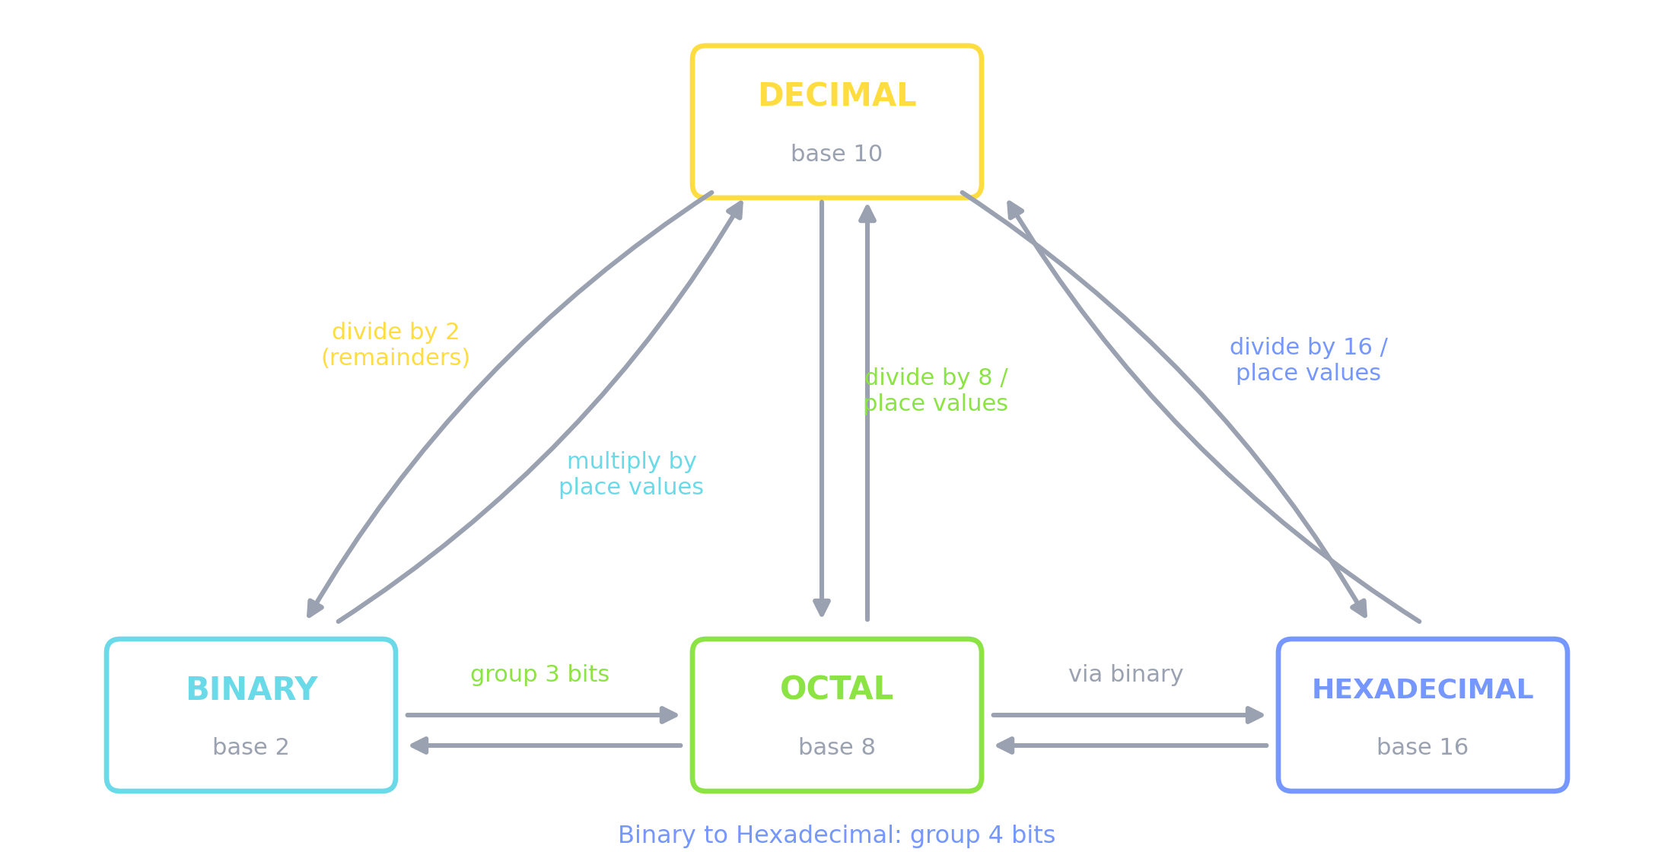
One Map for Every Conversion
Decimal is the hub for division and place-value methods; binary is the hub for grouping methods.

Slide 20

Decimal to Any Base: Successive Division
→ Step 1: divide the decimal number by the target base (2, 8 or 16).
→ Step 2: note down the remainder.
→ Step 3: keep dividing the quotient until it becomes zero.
→ Step 4: write the remainders in reverse order (bottom to top).
→ The first remainder is the LSB, the last remainder is the MSB.
→ The same recipe works for every base: only the divisor changes.

Slide 21
Solved: (25)₁₀ to Binary
25 ÷ 2 = 12
remainder 1
6 remainder 0
3 remainder 0
1 remainder 1
0 remainder 1
(LSB)
12 ÷ 2 =
6 ÷ 2 =
3 ÷ 2 =
1 ÷ 2 =
(MSB)
read the remainders bottom to top:
(25)10 = (11001)2
check: 16 + 8 + 0 + 0 + 1 = 25 OK

Slide 22
Solved: (12345)₁₀ to Binary
Presenter Notes
2026-08-24 17:39:38
--------------------------------------------
Fourteen divisions. Later we will see that hex gives the same answer in four divisions, which is why examiners think in hex.
12345 | ÷ | 2 | = | 6172 | r | 1 | (LSB) | 96 | ÷ | 2 | = | 48 | r | 0
6172 | ÷ | 2 | = | 3086 | r | 0 |  | 48 | ÷ | 2 | = | 24 | r | 0
3086 | ÷ | 2 | = | 1543 | r | 0 |  | 24 | ÷ | 2 | = | 12 | r | 0
1543 | ÷ | 2 | = | 771 | r | 1 |  | 12 | ÷ | 2 | = | 6 | r | 0
771 | ÷ | 2 | = | 385 | r | 1 |  | 6 | ÷ | 2 | = | 3 | r | 0
385 | ÷ | 2 | = | 192 | r | 1 |  | 3 | ÷ | 2 | = | 1 | r | 1
192 | ÷ | 2 | = | 96 | r | 0 |  | 1 | ÷ | 2 | = | 0 | r | 1 (MSB)
(12345)10 = (11 0000 0011 1001)2

Slide 23
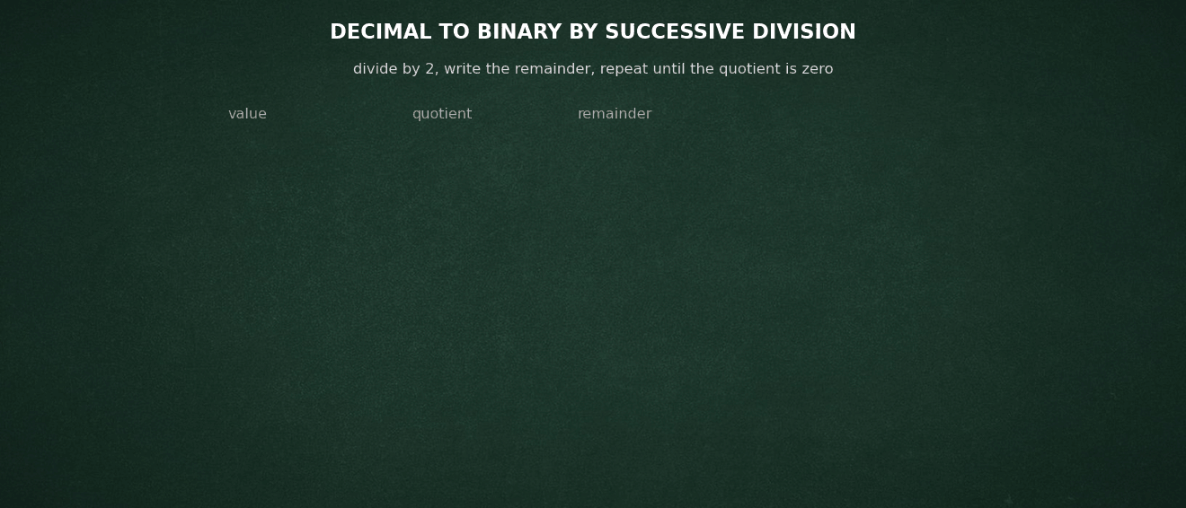
Successive Division, Watched
Presenter Notes
2026-08-24 17:39:39
--------------------------------------------
This animates in slideshow mode. Let it run once, then work a second number on the board with the class. The check line at the end matters: students should always verify by adding the place values back up, because a single transposed remainder is invisible otherwise.
2026 to binary, one division at a time, remainders read upward.

Slide 24
Solved: (12345)₁₀ to Octal and to Hex
to octal (divide by 8)
to hexadecimal (divide by 16)
12345 | ÷ | 8 | = | 1543 | r | 1 | 12345 | ÷ | 16 | = | 771 | r | 9
1543 | ÷ | 8 | = | 192 | r | 7 | 771 | ÷ | 16 | = | 48 | r | 3
192 | ÷ | 8 | = | 24 | r | 0 | 48 | ÷ | 16 | = | 3 | r | 0
24 | ÷ | 8 | = | 3 | r | 0 | 3 | ÷ | 16 | = | 0 | r | 3
3 | ÷ | 8 | = | 0 | r | 3
(12345)10 |  |  | = | (30071)8 |  | (12345)10 = |  |  |  | (3039)16

Slide 25
Solved: (725)₁₀ to Hex, and Decimal Fractions
Presenter Notes
2026-08-24 17:39:41
--------------------------------------------
Fractions: multiply the fractional part by 2, harvest the integer part each time, read downward. Stop when the fraction becomes 0 or enough precision is reached.
725 to hexadecimal
0.625 to binary (multiply by 2)
725 | ÷ | 16 | = | 45 | r | 5 | (5) | 0.625 | × | 2 | = | 1.25 | keep | 1
45 | ÷ | 16 | = | 2 | r | 13 | (D) | 0.25 | × | 2 | = | 0.5 | keep | 0
2 | ÷ | 16 | = | 0 | r | 2 | (2) | 0.5 | × | 2 | = | 1.0 | keep | 1, stop
(725)10 = (2D5)16 (0.625)10 = (0.101)2
remainders above 9 become letters integer parts are read top to bottom

Slide 26

Any Base to Decimal: Place Values
→ Step 1: write the position number of every digit, counting 0 from the right.
→ Step 2: the positional value of each digit is base^position (2⁰, 2¹, 2², ... for binary).
→ Step 3: multiply every digit by its positional value.
→ Step 4: add all the products: the sum is the decimal number.
→ Works identically for binary (powers of 2), octal (powers of 8) and hex (powers of 16).

Slide 27
Solved: (11011001)₂ to Decimal
bit: | 1 |  | 1 |  | 0 |  | 1 | 1 | 0 |  | 0 | 1
position: | 7 |  | 6 |  | 5 |  | 4 | 3 | 2 |  | 1 | 0
value: | 128 | 64 |  | 32 |  | 16 | 8 | 4 | 2 | 1
add the values where the | bit is | 1:
128 + 64 + 16 + 8 + 1 = | 217
(11011001)2 = (217)10

Slide 28
Solved: (345)₈ and (E5)₁₆ to Decimal
Presenter Notes
2026-08-24 17:39:43
--------------------------------------------
229 is used deliberately in all the following grouping examples so students see one value travelling across bases.
octal to decimal
hex to decimal
(345)8 |  |  |  |  |  | (E5)16
= 3×8^2 + 4×8^1 |  |  |  |  | + 5×8^0 | = E×16^1 + 5×16^0
= | 3×64 | + | 4×8 | + | 5×1 | = 14×16 | + 5×1
= | 192 | + | 32 | + | 5 | = 224 | + 5
= | 229 |  |  |  |  | = 229
same value, three faces:
(11100101)2 = (345)8 = (E5)16 = (229)10

Slide 29
Binary to Octal: Group 3 Bits
rule: 1 octal digit = exactly 3 bits, group from the right
pad the left with zeros
(11100101)2 = | 11 | 100 | 101
 | 011 | 100 | 101
 | │ | │ | │
 | 3 | 4 | 5
(11100101)2 = (345)8
reverse direction: replace every octal digit by its 3 bits (345)8 → 011 100 101 → (11100101)2

Slide 30
Binary to Hexadecimal: Group 4 Bits
rule: 1 hex digit = exactly 4 bits (one nibble), group from the right
(11100101)2 | = | 1110 | 0101
 |  | │ | │
 |  | E | 5
(11100101)2 | = (E5)16
reverse direction: replace every hex digit by its 4 bits (E5)16 → 1110 0101 → (11100101)2
this is why 1 byte is always exactly 2 hex digits in a hex editor

Slide 31
Octal to Hex: Travel via Binary
there is no direct grouping between base 8 and base 16, so binary is used as the interchange:
each octal digit to 3 bits
(345)8 → | 011 100 101
= | 011100101
= | 1110 0101
→ | (E5)16
regroup into 4-bit nibbles
hex to octal works the same way in reverse: 4-bit out, 3-bit in

Slide 32
Task 1: Conversions
Presenter Notes
2026-08-24 17:39:47
--------------------------------------------
Give the class 8 to 10 minutes. Encourage the hex-grouping shortcut for question 4: 500 = 0x1F4, then expand nibbles.
→ Convert binary to decimal:
(100100111001)₂
→ Convert hexadecimal to decimal:
(A1B8C5)₁₆
→ Convert octal to decimal:
(74321)₈
→ Convert (500)₁₀ to binary, octal and hexadecimal.
→ Why can 743924 never be an octal number?

Slide 33
Task 1: Answers
(100100111001)2 = 1001 0011 1001 = 0x939
= 2048+256+32+16+8+1 = (2361)10
(A1B8C5)16 = 10×16^5+1×16^4+11×16^3+8×16^2+12×16+5
= 10485760+65536+45056+2048+192+5 = (10,598,597)10
(74321)8 = 7×4096+4×512+3×64+2×8+1 = (30,929)10
(500)10 = (111110100)2 = (764)8 = (1F4)16
because 9 is not a valid digit in base 8 (digits 0-7 only)

Slide 34

0/
PART 3 OF 5 · OPERATIONS
Operations on Binary Numbers

Slide 35
Rules of Binary Addition
Presenter Notes
2026-08-24 17:39:49
--------------------------------------------
Case 4: one plus one is (10) in binary, write 0 carry 1, exactly like 9 plus 1 in decimal.
Case | A + B | Sum | Carry
1 | 0 + 0 | 0 | 0
2 | 0 + 1 | 1 | 0
3 | 1 + 0 | 1 | 0
4 | 1 + 1 | 0 | 1 (carried to the next column)
5 | 1 + 1 + 1 | 1 | 1 (when a carry arrives too)

Slide 36
Binary Addition: Worked Examples
example 1
example 2
carry | 1 | 1 |  |  |  | carry | 1 1 1 1 1
1 | 1 | 0 | 1 0 | = | 26 | 0 0 0 | 1 0 0 1 1 | = 19
+ 0 | 1 | 1 | 0 0 | = | 12 | + 0 0 1 | 1 1 1 1 0 | = 62
─────────── |  |  |  |  |  | ─────────────────
1 0 0 1 1 0 |  |  |  | = | 38 | 0 1 0 1 0 0 0 1 = |  | 81
always verify by converting the operands and the result to decimal

Slide 37
Binary Subtraction: Rules and Example
rules: | 0 | - | 0 | = | 0 |  | 1 - 0 = |  | 1 | 1 - 1 = 0
 | 0 | - | 1 | = | 1 | with | a borrow |  | of 1 | from the next column
example: |  |  |  | 1 | 1 | 0 1 | = | 13
 | - |  |  | 1 | 0 | 1 0 | = | 10
─────────
0 0 1 1 = 3
column 1: 0 - 1 → borrow: 10 - 1 = 1, and column 2 repays the loan hardware rarely subtracts this way: it adds the 2's complement

Slide 38
1's Complement
→ The 1's complement of a binary number is found by flipping every bit: all 1s become 0s and all 0s become 1s.
→ Example: 1 0 1 0 1 → 0 1 0 1 0
→ Example on a full byte: 0000 1100 (12) → 1111 0011
→ It is the stepping stone to the 2's complement, which is how every modern computer represents negative numbers.

Slide 39


2's Complement
→ 2's complement = 1's complement + 1 (add 1 at the LSB).
→ Example for 12 on 8 bits: 0000 1100 → flip → 1111 0011 → add 1 → 1111 0100 (= -12).
→ Why computers use it:
subtraction becomes addition, so the ALU needs only an adder circuit
there is a single representation of zero
the MSB doubles as the sign bit: 0 = positive, 1 = negative
→ The same byte 1111 0100 is 244 unsigned but -12 signed: context decides.

Slide 40
Subtraction Using 2's Complement
compute
26 - 12
on 8 bits:
26 |  | = | 0 | 0 | 0 | 1 | 1 | 0 | 1 | 0
12 |  | = | 0 | 0 | 0 | 0 | 1 | 1 | 0 | 0
2's | comp(12) | = | 1 | 1 | 1 | 1 | 0 | 1 | 0 | 0
0 0 0 1 1 |  | 0 | 1 0 | (26)
+ 1 1 1 1 0 |  | 1 | 0 0 | (-12)
flip all bits, add 1
─────────────────
1 0 0 0 0 1 1 1 0 → discard the carry-out
result: 0 0 0 0 1 1 1 0 = 14 OK

Slide 41
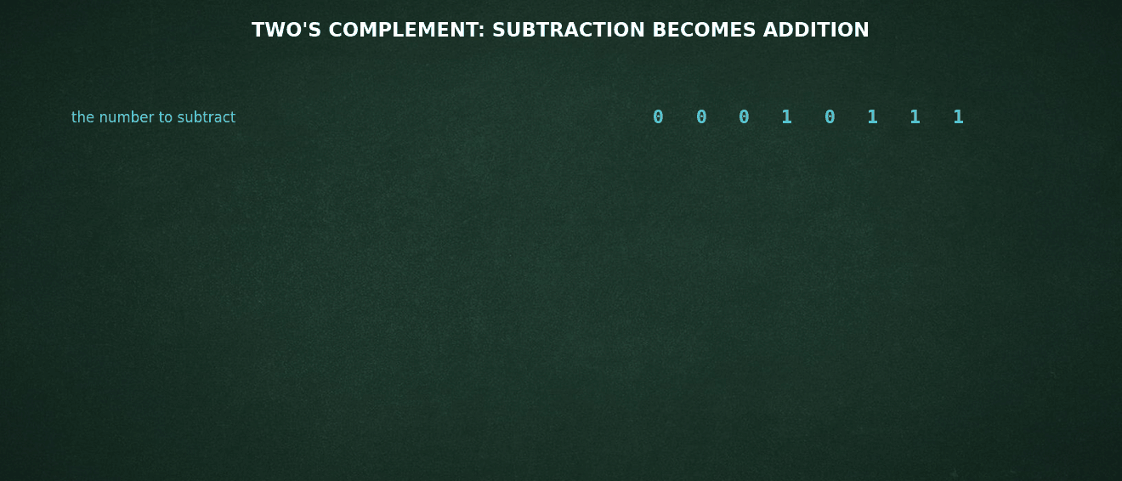
Two's Complement, Watched
Presenter Notes
2026-08-24 17:39:55
--------------------------------------------
The line to land is that the CPU has no subtractor. It has one adder and a bit inverter, and every subtraction in every program you have ever run is really an addition. That is also why signed overflow wraps silently instead of raising an error, which is where a whole family of bugs and exploits comes from.
Invert, add one, add, and discard the ninth bit.

Slide 42
Signed Numbers and Ranges
→ With n bits, the unsigned range is 0 to (2^n) - 1, and the signed range is -(2^(n-1)) to +(2^(n-1)) - 1.
→ One byte: unsigned 0 to 255, signed -128 to +127.
→ 32 bits: unsigned 0 to 4,294,967,295; this is why 32-bit counters and 32-bit timestamps overflow.
→ Forensic angle: the same stored bytes can be read as signed or unsigned; a tool that guesses wrongly shows impossible values (negative file sizes, dates before 1970).
→ Forensic angle: the 32-bit Unix time counter overflows on 19 January 2038, a known interpretation trap.

Slide 43
When the Number Runs Out of Room
Presenter Notes
2026-08-24 17:39:57
--------------------------------------------
This slide converts an abstract arithmetic point into a practical one. Students who have seen a 1970 timestamp usually assume corruption or tampering. Teach them to ask first whether the field was zero, or whether the width overflowed. It is the most common false positive in timeline work.
→ A fixed-width integer has no more room at the top, so it wraps. Add 1 to the largest signed 8-bit value, 127, and you get -128. No error, no warning.
→ The 2038 problem: a 32-bit signed Unix timestamp counts seconds from 1 January 1970. It runs out at 03:14:07 UTC on 19 January 2038 and wraps to December 1901.
→ This is not hypothetical for us: embedded devices, routers, cameras, older filesystems and long-lived logs still use 32-bit time.
→ The forensic tell: a timestamp of 1901, or 1970, or a wildly future date is usually not a suspect covering tracks. It is an integer that overflowed, or a zero value rendered through an epoch.
→ FAT stores the year in 7 bits offset from 1980, so its range ends in 2107. NTFS and the registry use 64-bit FILETIME and are safe for a very long time.
→ The rule: before you accuse anyone of timestomping, check whether the number simply ran out of room.

Slide 44
Binary Multiplication
rules: 0×0=0
0×1=0
1×0=0
1×1=1
(no carries in the rule)
1 0 1
× 1 1 0
───────
0 0 0
1 0 1
1 0 1
─────────
1 1 1 1 0
= 5
= 6
partial products, shifted left
= 30 OK
multiply by 0 or 1 only, then one binary addition at the end

Slide 45
Binary Division
compute 101010 ÷ 110
(42 ÷ 6):
quotient: 1 1 1 = 7
1 1 1
─────────
110 ) 1 0 1 0 1 0
- 1 1 0
─────────
1 0 0 1
110 fits into 1010
bring down the next bit
- 1 1 0
───────
1 1 0
bring down the last bit
- 1 1 0
──────
0
remainder 0, so 42 ÷ 6 = 111 (7) exactly

Slide 46

Task 2: Binary Arithmetic
Presenter Notes
2026-08-24 17:40:00
--------------------------------------------
About 8 minutes. Question 5 connects back to the F4 = -12 example from the 2s complement slide.
→ Add: (1011)₂ + (1101)₂
→ Subtract using the 2's complement method (8 bits): (21)₁₀ - (13)₁₀
→ Multiply: (110)₂ × (101)₂
→ Write the 1's complement and the 2's complement of 0101 0110.
→ The byte F4 appears in a signed field. What decimal value does it hold?

Slide 47
Task 2: Answers
1011 + 1101 = 11000 (11 + 13 = 24 OK)
21 = 00010101, 13 = 00001101, 2's comp(13) = 11110011
00010101 + 11110011 = 1 00001000 → drop carry → 00001000 = 8
110 × 101 = 11110 (6 × 5 = 30 OK)
0101 0110 → 1's comp 1010 1001 → 2's comp 1010 1010
F4 = 1111 0100, MSB is 1 so negative: value = -12

Slide 48
04
PART 4 OF 5 · BYTE ORDERING
Little-Endian and Big-Endian

Slide 49

What is Endianness?
→ A single byte has no ordering problem, but values such as 16-, 32- and 64-bit integers span several bytes.
→ Endianness is the order in which those bytes are stored in memory or on disk.
→ Big-endian: the most significant byte comes first (at the lowest address).
→ Little-endian: the least significant byte comes first.
→ The names come from Gulliver's Travels, where two nations fight over which end of a boiled egg to crack.
→ Both conventions are valid; problems appear only when the reader assumes the wrong one.

Slide 50



Two Conventions, One Value: 0x12345678
Presenter Notes
2026-08-24 17:40:03
--------------------------------------------
Emphasise: Windows evidence is overwhelmingly little-endian, network captures are big-endian.
BIG-ENDIAN
→ Bytes stored as 12 34 56 78
→ MSB at the lowest address, like human left-to-right reading
→ Used by: network protocols ("network byte order"), Motorola 68k, SPARC, PowerPC
→ File formats: JPEG segment lengths, PNG chunk lengths
LITTLE-ENDIAN
→ Bytes stored as 78 56 34 12
→ LSB at the lowest address
→ Used by: Intel and AMD x86 / x64, nearly all ARM systems as configured
→ On-disk structures: MBR, GPT, FAT, NTFS values are little-endian

Slide 51
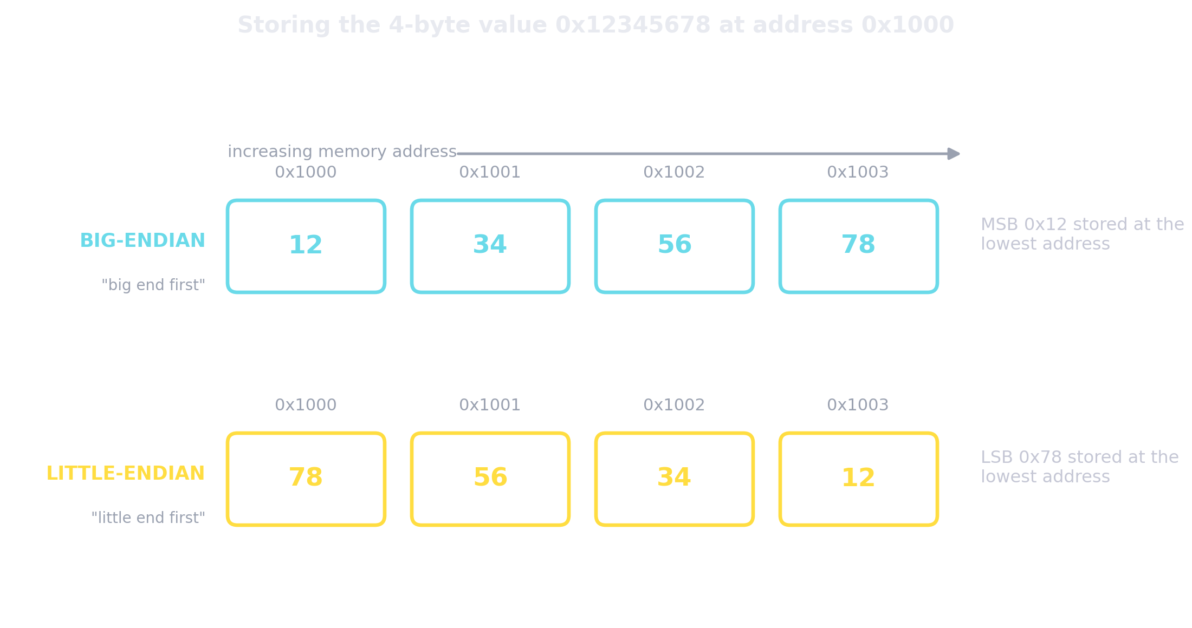
Endianness in Memory
Same value, same addresses, two storage orders. The hex editor shows only the byte sequence.

Slide 52
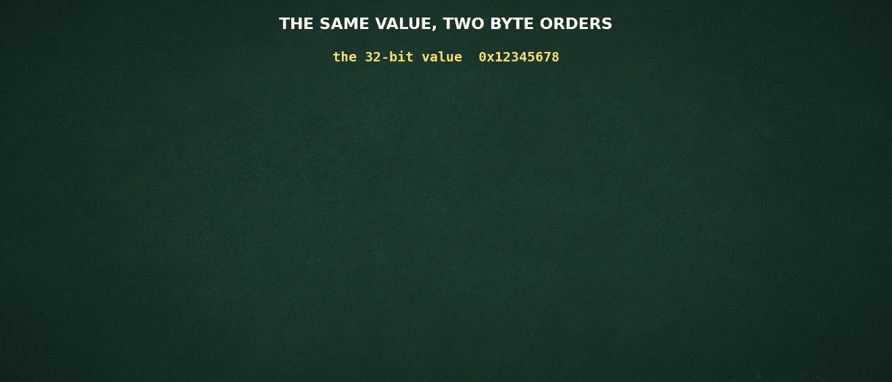
Two Byte Orders, Watched
Presenter Notes
2026-08-24 17:40:05
--------------------------------------------
The two decimal numbers at the end are the payoff: 305,419,896 against 2,018,915,346, from identical bytes. Then connect it forward: interpreted as a Unix timestamp those two numbers are 34 years apart. Byte order is not a formatting detail, it is the difference between two different findings.
0x12345678 into memory both ways, and the value you get if you misread it.

Slide 53
Reading Multi-Byte Values by Hand
a hex editor shows these bytes at some offset:
00 08 00 00
read as 32-bit little-endian (reverse the bytes):
00 00 08 00 → 0x00000800 = 2048
(a very common partition starting sector)
read as 32-bit big-endian (as printed):
0x00080000 = 524,288 ...a wildly different number
same four bytes, two interpretations: the format specification decides which one is true

Slide 54
Endianness: The Forensic Angle
Presenter Notes
2026-08-24 17:40:07
--------------------------------------------
Show a real MBR in a hex editor and decode a partition start LBA live if time permits; the same exercise returns in Session 3.
→ Partition tables, FAT and NTFS metadata, registry data and Windows timestamps are stored little-endian: reverse the bytes before converting.
→ Network packet captures use big-endian fields; PNG and JPEG internal lengths are big-endian too.
→ EXIF metadata declares its own order: a TIFF header starting II (0x49 0x49) is little-endian (Intel), MM (0x4D 0x4D) is big-endian (Motorola).
→ Forensic suites convert automatically, but manual carving and hex-level verification do not: you are the endianness engine.
→ Rule of thumb for Windows disk evidence: read the bytes right to left.

Slide 55
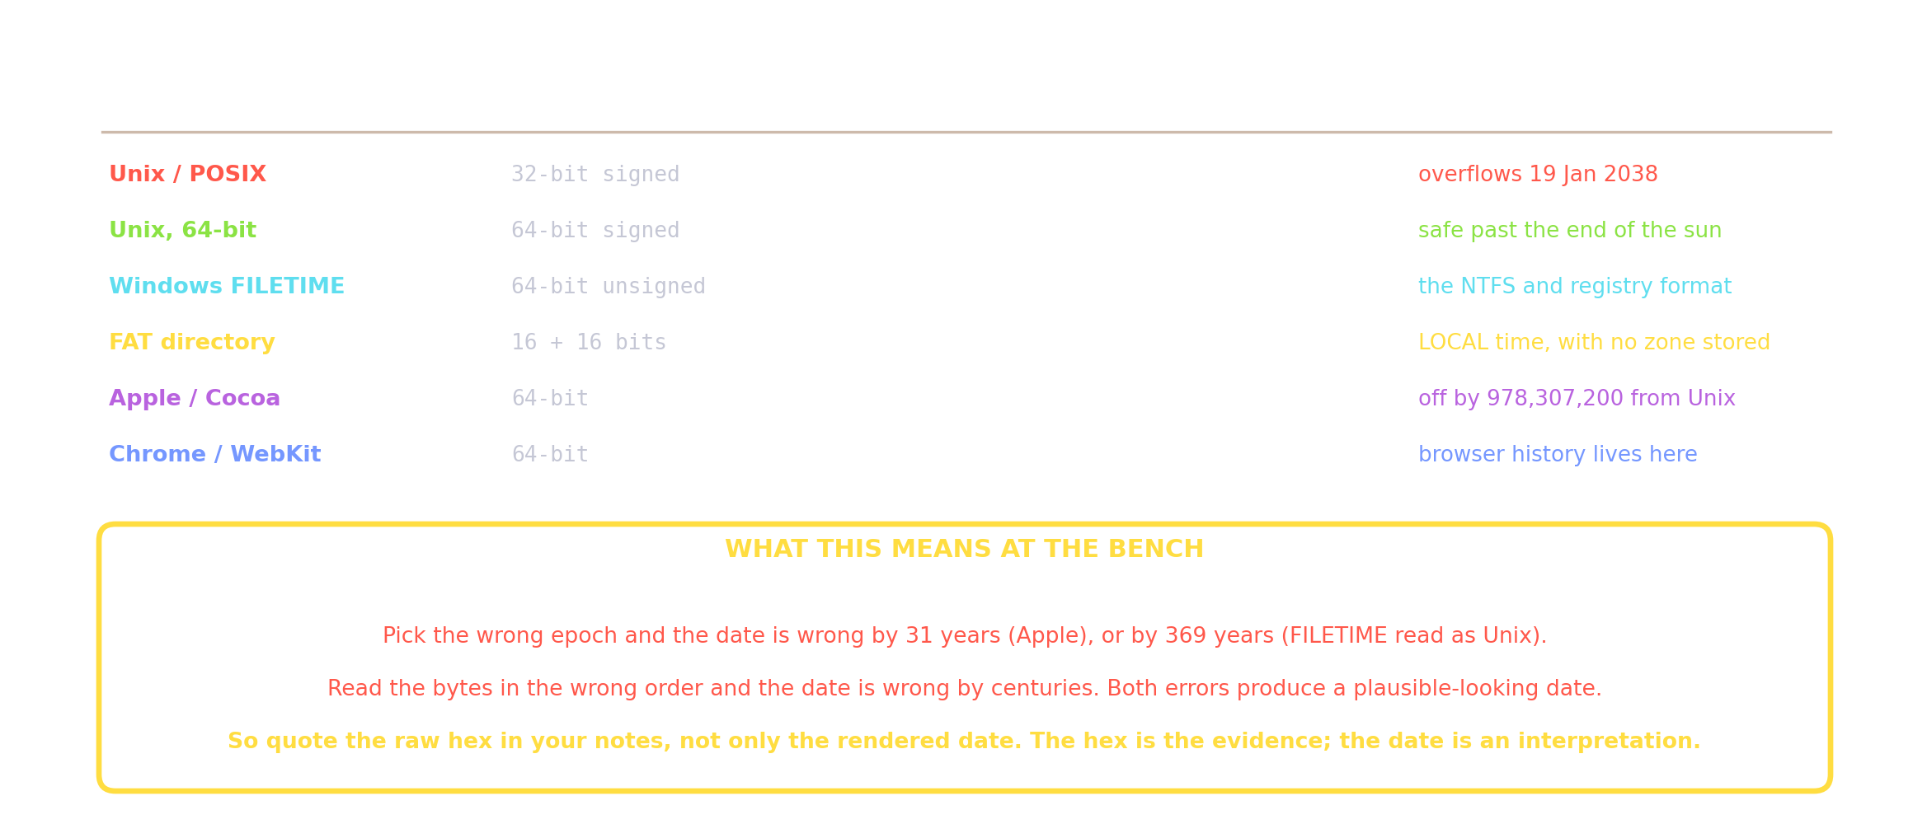
Every Timestamp Is Just a Number
Presenter Notes
2026-08-24 17:40:08
--------------------------------------------
This is the single most useful reference slide in the session. Two errors produce plausible wrong dates: the wrong epoch, and the wrong byte order. Both give you a date that looks like a date. The defence against both is the last line: record the raw hex in your notes alongside the rendered date, so the interpretation can be checked later.
Six formats, four epochs, and the two errors each one invites.

Slide 56
05
PART 5 OF 5 · CHARACTER ENCODING
ASCII and Unicode Encodings

Slide 57
From Numbers to Text
→ Computers store only numbers, so text needs a character encoding: an agreed table mapping characters to numeric codes and bytes.
→ A character set lists the characters and their code numbers; an encoding
defines the exact bytes used to store those numbers.
→ Without the correct encoding, bytes decode into garbage (mojibake), or a keyword search silently fails to match the evidence.
→ Two families dominate real cases: ASCII (and its 8-bit extensions) and Unicode
(UTF-8, UTF-16).

Slide 58

ASCII
→ American Standard Code for Information Interchange, standardised in 1963.
→ A 7-bit code: 128 characters, codes 0 to 127.
→ Codes 0 to 31 are control characters (line feed, carriage return, tab, null); 32 to 126 are printable; 127 is DEL.
→ Stored one character per byte, with the top bit 0: plain English text is instantly readable in any hex editor.
→ Patterns worth knowing: digits start at 0x30 ("0" = 48), uppercase at 0x41 ("A" = 65), lowercase at 0x61 ("a" = 97).
→ Changing one bit (0x20) switches case: 'A' 0100 0001 'a' 0110 0001.

Slide 59
ASCII Codes Every Examiner Knows
Presenter Notes
2026-08-24 17:40:12
--------------------------------------------
Windows text lines end CR LF = 0D 0A, Unix lines end LF = 0A alone: a quick way to tell where a text file was authored.
Character | Decimal | Hex | Character | Decimal | Hex
NUL | 0 | 00 | '0' to '9' | 48 - 57 | 30 - 39
LF (new line) | 10 | 0A | 'A' to 'Z' | 65 - 90 | 41 - 5A
CR (return) | 13 | 0D | 'a' to 'z' | 97 - 122 | 61 - 7A
Space | 32 | 20 | DEL | 127 | 7F

Slide 60
Extended ASCII and Code Pages
→ Using the 8th bit gives codes 128 to 255: an extra 128 characters.
→ But there was no single standard: IBM CP437 filled it with box-drawing symbols, Windows-1252 with Western European letters, ISO-8859 with regional families.
→ The same byte means different characters in different code pages: byte 0xE9 is é in Windows-1252 but Θ in CP437.
→ Result: documents exchanged between systems decoded wrongly, and 256 codes could never cover scripts such as
Devanagari, Chinese or Arabic.
→ The permanent fix is Unicode: one universal character set for every script.

Slide 61
Unicode
Presenter Notes
2026-08-24 17:40:14
--------------------------------------------
Before we talk about bytes at all, we need the vocabulary, because two ideas get confused constantly and the confusion is where encoding bugs live.
Unicode is one universal table. Every character of every script — Latin, Devanagari, Han, emoji — gets a unique number called a code point, written in hex with a U+ prefix. Capital A is U+0041. That is all Unicode is: an enormous, agreed-upon numbering.
The code space runs U+0000 to U+10FFFF — about 1.1 million slots arranged in 17 planes. Plane zero, the Basic Multilingual Plane, holds nearly every modern script you will meet in casework; Devanagari sits at U+0900 to U+097F. Emoji and the rarer historic scripts live in the supplementary planes above U+FFFF, and that boundary matters later when we hit surrogate pairs in UTF-16. Now the line to hold onto: Unicode assigns the numbers, but it does not say how those numbers are stored. That is the job of the encodings — UTF-8, UTF-16, UTF-32. Same character, same code point, completely different bytes on disk depending on the encoding. Every one of the next few slides is really about that gap.
→ One universal table, maintained by the Unicode Consortium: every character of every script gets a unique number called a code point, written U+hex, e.g. U+0041 is A.
→ Code space: U+0000 to U+10FFFF, i.e. 1,114,112 possible code points in 17 planes.
→ Plane 0, the Basic Multilingual Plane (BMP), holds almost all modern scripts;
Devanagari occupies U+0900 to U+097F.
→ Emoji and rare scripts live in the supplementary planes above U+FFFF.
→ Unicode assigns the numbers; the encodings UTF-8, UTF-16 and UTF-32
define how those numbers become bytes.

Slide 62
The Unicode Consortium
Presenter Notes
2026-08-24 17:40:15
--------------------------------------------
Give the class thirty seconds on who owns this problem. Unicode is not an ISO committee or a company; it is a small non-profit whose members are the platform vendors, and its output is the table every device you will examine agrees on. CLDR and ICU matter to us because they are the code paths through which the standard actually reaches Windows, Android and iOS. The release rhythm is annual, and nothing ever gets deleted, which is why a ten-year-old image still decodes correctly today. Point students at the two sites now, because the following slides quote them.
→ The standard is maintained by the Unicode Consortium, a non-profit with one goal: everyone in the world should be able to use their own language on phones and computers.
→ Its promise: a unique number for every character, no matter what the platform, no matter what the program, no matter what the language.
→ Around it the Consortium also maintains CLDR (locale data used by every major OS) and ICU (the libraries most software uses to implement Unicode).
→ A major version ships every year, targeted at the third quarter; a code point, once assigned, is never removed or reassigned.
→ home.unicode.org introduces the project; unicode.org carries the specifications, charts and FAQs this session cites.

Slide 63
Unicode 17.0: The Standard Today
Presenter Notes
2026-08-24 17:40:17
--------------------------------------------
Numbers to anchor the scale: just under 160 thousand characters, 172 scripts, an annual drumbeat of additions. The four new scripts will mean nothing to most students, which is the point: Unicode grows at the edges of the world's writing systems. The stability policy is the forensically load-bearing fact: a code point can be added but never removed or renamed, so decoding stays stable across decades. The forensic angle is version skew: a file name using a brand-new character is not corruption, just a tool with an older table.
→ Current version: Unicode 17.0.0, released 9 September 2025; a new major version arrives every year in the third quarter.
→ It encodes 159,801 characters across 172 scripts, after 4,803 additions in this release.
→ Four new scripts arrived in 17.0: Sidetic, Tolong Siki, Beria Erfe and Tai Yo.
→ CJK Unified Ideographs Extension J added 4,298 ideographs, taking the CJK total past 100,000 characters.
→ Stability policy: a published character is never removed, renamed or reassigned, so old evidence always decodes the same way tomorrow.
→ Forensic angle: record the Unicode version your tools implement; a 17.0-only character in a file name renders as boxes in older tools, and that is not corruption.

Slide 64
The Seventeen Planes
Presenter Notes
2026-08-24 17:40:18
--------------------------------------------
The map matters because UTF-16's surrogate mechanism and half of the lookalike tricks live at plane boundaries. Plane 0 is where casework happens; plane 1 is where emoji live, which is why chat exports keep tripping tools that assume the BMP is everything. Planes 15 and 16 are private use: fonts and apps can privately agree on meanings there, so a private-use code point inside a file name is a deliberate act worth investigating. The 1.1 million figure is 17 times 65,536, and only about a seventh of it is assigned so far.
17 planes x 65,536 = 1,114,112 possible code points
plane 0 0000 - FFFF
BMP: nearly all modern scripts
Devanagari 0900-097F, surrogates D800-DFFF
plane | 1 | 10000 | - 1FFFF | SMP: | emoji, symbols, historic scripts
plane | 2 | 20000 | - 2FFFF | SIP: | rare CJK ideographs (Ext. B to F)
plane | 3 | 30000 | - 3FFFF | TIP: | CJK Ext. G to J (J is new in 17.0)
planes 4-13
plane 14
planes 15-16
unassigned: room for decades of growth tags and variation selectors
private use: no standard meaning at all
E0000 ...
a private-use or unassigned code point in a file name is a choice someone made: look twice

Slide 65
UTF-8
Presenter Notes
2026-08-24 17:40:19
--------------------------------------------
Unicode gave us the numbers. UTF-8 is the first and most important answer to the question of how those numbers actually become bytes on a disk.
The key word is variable-length — one to four bytes per character, depending on how far up the code space the character sits. And the first design decision is the one that made UTF-8 win: code points zero through 127 encode as a single byte, bit-identical to ASCII. That means every ASCII file ever written is already a valid UTF-8 file. No conversion, no flag day. Above 127 you get the marked patterns on screen. Read them structurally rather than memorising them: the number of leading 1 bits in the first byte tells you the total length, and every continuation byte opens with 10. We will encode one by hand in a moment.
Two things to carry into casework. First, ubiquity — UTF-8 is what you meet on the web, on Linux and macOS, and inside the SQLite databases that back nearly every chat app and browser. Second, that 10 prefix is a resynchronisation marker. Land in the middle of a damaged stream and you can still find the next character boundary, which is exactly what carving fragments demands.
→ A variable-length encoding: each code point becomes 1 to 4 bytes.
→ Code points 0 to 127 are stored exactly like ASCII in one byte: every ASCII file is already valid UTF-8.
→ Multi-byte characters use marked patterns:
2 bytes: 110xxxxx 10xxxxxx 3 bytes: 1110xxxx 10xxxxxx 10xxxxxx
4 bytes: 11110xxx 10xxxxxx 10xxxxxx 10xxxxxx
→ Dominant on the web, Linux, macOS, and inside SQLite databases (chat apps, browsers).
→ Continuation bytes always start 10, so a reader can resynchronise mid-stream: helpful when carving fragments.

Slide 66
UTF-8 Worked Example: the € Sign
Presenter Notes
2026-08-24 17:40:20
--------------------------------------------
Let's do one by hand, because UTF-8 stops feeling like magic the moment you encode a character yourself.
Take the euro sign, U+20AC. In binary that is fourteen significant bits — too many for one byte, too many for two, so we reach for the three-byte form. The template is fixed: the lead byte starts 1110, and both continuation bytes start 10. Count the free slots — four, then six, then six — sixteen slots for fourteen bits. Pour the code point in, right-aligned, and you get 11100010 10000010 10101100, which in hex is E2 82 AC. Now look at the two comparison cases. Capital A is U+0041 and encodes as the single byte 41 — byte-for-byte identical to ASCII, which is the compatibility guarantee that let UTF-8 win. The Devanagari ह is U+0939 and takes three bytes, like the euro. So cost scales with where you sit in the code space, not with which script you happen to write in.
The line at the bottom is the one to remember: the leading byte declares the total length. 1110 means "three bytes, starting here." That self-describing property is what the next slide animates, and it is what makes UTF-8 recoverable from a damaged stream.
code point: € = U+20AC = 0010 0000 1010 1100
(needs 3 bytes)
template: fill bits:
1110xxxx 11100010
10xxxxxx 10000010
10xxxxxx 10101100
bytes: E2 82 AC
more examples:
'A' U+0041 → 41
ह U+0939 → E0 A4 B9
(1 byte, pure ASCII) (Devanagari, 3 bytes)
the leading byte announces the length: 1110... means 3 bytes total

Slide 67
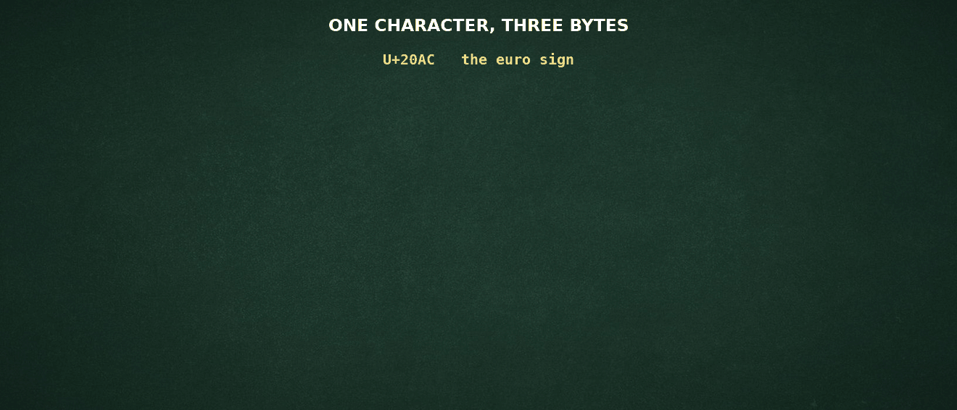
One Character, Three Bytes
Presenter Notes
2026-08-24 17:40:21
--------------------------------------------
The closing line is the forensic point and it is not obvious. Because the marker bits distinguish a lead byte from a continuation byte, a decoder that lands anywhere in a UTF-8 stream can resynchronise to the next character boundary. That is exactly the situation a carver is in, and it is why UTF-8 text survives fragmentation better than UTF-16 does. This is the same conversion you just saw on the board, only now in motion. Watch the code point U+20AC — the euro sign — get chopped into three pieces and dropped into the three-byte UTF-8 template. The lead byte opens with 1110, announcing "three bytes follow me, counting myself." Each continuation byte opens with 10, announcing "I am not a start, I am a payload." Fill the free slots with the code point's bits and you land on E2 82 AC. Notice what the marker bits are actually buying us. They are pure overhead — eight of the twenty-four bits carry no character data at all. That looks wasteful until you are the one holding a damaged image.
Here is the forensic point, and it is not obvious. Because a lead byte and a continuation byte are structurally distinguishable, a decoder that lands at a random offset in a UTF-8 stream can skip forward and resynchronise at the next real character boundary. It loses one character, not the rest of the file. That is exactly the position a carver is in on a fragmented volume. It is the reason UTF-8 text recovers gracefully where UTF-16 — which we look at next — does not.
U+20AC becoming E2 82 AC, marker bits and all.

Slide 68

UTF-16
→ Encodes BMP code points as one 16-bit unit (2 bytes); code points above U+FFFF need two units: a surrogate pair (4 bytes).
→ Surrogates: high D800 - DBFF, then low DC00 - DFFF; these ranges are reserved and never appear alone.
→ Comes in UTF-16LE and UTF-16BE; Windows is UTF-16LE internally: NTFS file names, the registry, and strings in RAM.
→ Latin text in UTF-16LE alternates with zero bytes: 'N' 'F' 'S' 'U' becomes 4E 00 46 00 53 00 55 00.
→ Forensic angle: that interleaved-zero pattern is the visual signature of Windows strings in a hex dump.

Slide 69
UTF-16 Worked Examples
BMP characters: | one 16-bit unit
'A' = U+0041 | → units 0041 | → | LE | bytes 41 00
ह = U+0939 | → units 0939 | → | LE | bytes 39 09
beyond the BMP: surrogate pair, e.g. U+1F600 (grinning face)
subtract | 0x10000: |  |  |  | 0x0F600
split 20 | bits into 10 |  | + | 10: | 0000111101 / 1000000000
high = D800 |  | + 0x03D = | D83D |  | low = DC00 + 0x200 = DE00
LE bytes on |  | disk: 3D | D8 00 |  | DE
emoji in chat evidence are surrogate pairs in UTF-16 exports

Slide 70
UTF-32
Presenter Notes
2026-08-24 17:40:23
--------------------------------------------
One slide of completeness: students should know the third encoding form exists and why they will rarely see it on disk. The value IS the code point, which makes it the easiest form to decode by hand and the most wasteful to store. Show the three zero bytes: that pattern in a memory dump usually means an application's internal string buffer rather than a file. Search tools default to UTF-8 and UTF-16, so UTF-32 content must be requested explicitly.
→ The third encoding form: every code point becomes exactly one 32-bit unit, four bytes, zero padded.
→ 'A' = U+0041 is stored as 41 00 00 00 in UTF-32LE: the code point is the value, with no surrogates and no length rules.
→ Fixed width makes indexing trivial but storage heavy: plain ASCII text grows four-fold, so files on disk rarely use it.
→ BOMs: 00 00 FE FF big-endian, FF FE 00 00 little-endian; you meet UTF-32 mostly in memory (Python strings, Linux wchar_t) and tool exports.
→ Forensic angle: a search tuned for UTF-8 and UTF-16 misses UTF-32 text; the giveaway is three zero bytes per Latin character.

Slide 71
Byte Order Marks (BOM)
Presenter Notes
2026-08-24 17:40:24
--------------------------------------------
A BOM at offset 0 of a carved fragment identifies the text encoding instantly: endianness and encoding in one glance.
Encoding | BOM bytes at file start | Meaning
UTF-8 | EF BB BF | optional signature, order fixed anyway
UTF-16 LE | FF FE | units are little-endian (Windows default)
UTF-16 BE | FE FF | units are big-endian
UTF-32 LE | FF FE 00 00 | rare, 4-byte units
UTF-32 BE | 00 00 FE FF | big-endian, 4-byte units

Slide 72
Normalization: One Character, Two Spellings
Presenter Notes
2026-08-24 17:40:26
--------------------------------------------
This slide explains a class of false negatives nobody suspects. Two byte sequences, one glyph: e-acute precomposed versus e plus combining acute. A keyword search, a file name comparison and a string hash all operate on bytes, so the NFC and NFD versions of one word simply miss each other. macOS historically writes decomposed names; Windows stores what it is given. The discipline: normalize both sides before comparing, and write the chosen form into the report so the comparison is reproducible.
→ Unicode can write one visible character two ways: é is U+00E9 precomposed, or e (U+0065) followed by the
combining accent U+0301.
→ In UTF-8 those become C3 A9 versus 65 CC 81: different bytes, identical rendering.
→ The standard defines normalization forms to reconcile them: NFC composes, NFD decomposes (Unicode Standard Annex #15, unicode.org).
→ Windows keeps file names as typed; macOS historically decomposes them, so one name copied across systems can
change bytes without changing looks.
→ Un-normalized comparison therefore breaks keyword hits, deduplication and string hashes.
→ Forensic angle: normalize before comparing names or hashing strings, and state the form (NFC or NFD) in your report.

Slide 73
Character Encoding: The Forensic Angle
Presenter Notes
2026-08-24 17:40:26
--------------------------------------------
Live demo idea: run strings and strings -e l on a small registry hive and compare hit counts.
→ A keyword search that only tries ASCII / UTF-8 misses UTF-16LE hits in registry hives, $MFT names, lnk files and memory: search both.
→ The classic strings utility needs -e l to surface UTF-16LE text ('strings -e l memory.dmp').
→ Chat and browser databases (WhatsApp, Telegram, Chrome) are SQLite, usually UTF-8, emoji included as multi-byte sequences.
→ File names in NTFS are UTF-16LE; the same name carved from a FAT volume may be 8.3 ASCII plus a UTF-16 long-name entry.
→ When text looks like garbage, suspect the decoder, not the data: retry with another encoding or code page.

Slide 74
unicode.org: The Examiner's Reference
Presenter Notes
2026-08-24 17:40:28
--------------------------------------------
Close the loop on where authority lives. When an unfamiliar glyph appears in a file name, the code charts identify it in a minute. When a lookalike attack is suspected, UTS #39's confusables data is the citable source, not 'it looked similar to me'. And when a finding depends on a character property, cite the version of the standard, because properties can be refined between versions even though code points never move.
→ Code charts: a PDF chart for every block, the fastest way to identify an unfamiliar glyph in a name or document.
→ The Unicode Character Database records every character's properties: script, category, numeric value, bidirectional class.
→ Where is my Character?, the glossary and the UTF-8/UTF-16 FAQ answer the practical questions this session raised.
→ UTS #39, Unicode Security Mechanisms, catalogues the confusable characters behind the lookalike names on the next slide.
→ Findings that rest on a character property should cite the exact version, 17.0.0; archived versions keep those citations checkable.

Slide 75
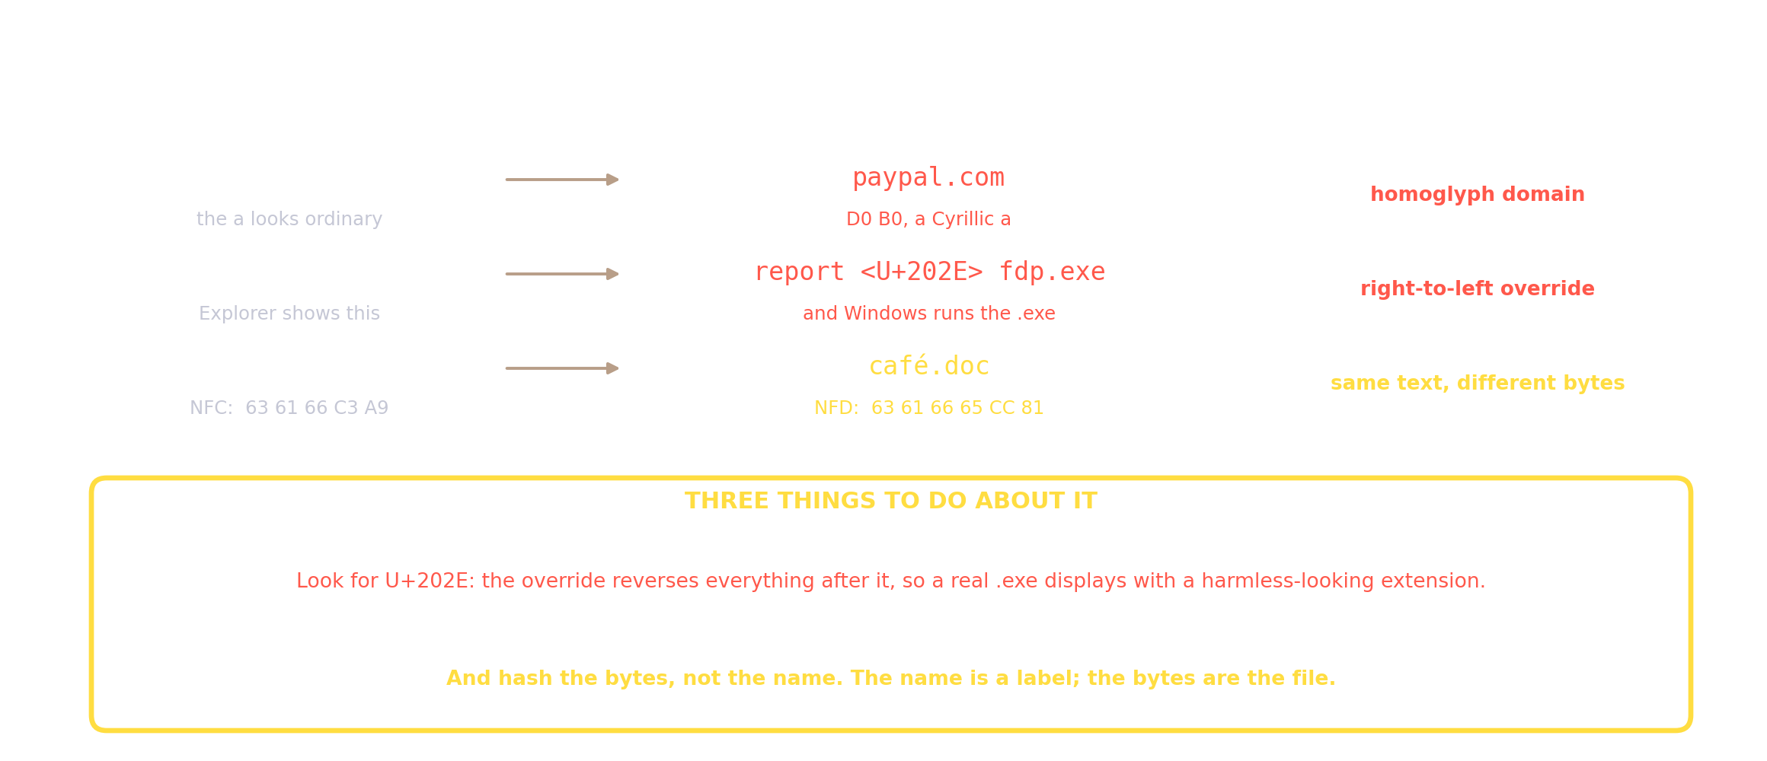
When Two Names Look Identical
Presenter Notes
2026-08-24 17:40:28
--------------------------------------------
All three rows are live attacker techniques. The middle one is the nastiest: U+202E reverses everything after it, so a file really named report<U+202E>fdp.exe shows in Explorer as reportexe.pdf while Windows still runs it as an executable. The third row is the subtle one: cafe with an acute accent is C3 A9 in NFC but 65 CC 81 in NFD, so two identical-looking filenames differ in bytes and in hash. Bottom line: hash the bytes, never the name.
On NFC vs NFD: these are the two Unicode normalization forms, and both are legal encodings of the same visible text. NFC is composed — é is stored as one code point, U+00E9, which is C3 A9 in UTF-8. NFD is decomposed — the same character is a base letter plus a combining mark, e (U+0065) plus combining acute (U+0301), which is 65 CC 81. Same glyph on screen, different bytes, different hash, and a failed byte-for-byte string comparison. Why this bites in practice: platforms disagree. macOS has historically stored filenames decomposed, while Windows and Linux typically pass composed input straight through. So the same file copied across systems can change its bytes without changing its appearance — and a hash mismatch on two visually identical names is a normalization question before it's a tampering question.
The working rule: normalize to a single form before comparing, deduplicating, or indexing, and hash the byte stream rather than the filename.
A Cyrillic lookalike, a right-to-left override, and two encodings of one word.

Slide 76
Seeing It Yourself
Presenter Notes
2026-08-24 17:40:29
--------------------------------------------
Set these as the home practice. Students who have run xxd on a file with a right-to-left override in its name never forget the technique. The date command is the fastest way to show the 2038 ceiling is real rather than folklore.
→ Five commands that turn every idea in this session into something you can check:
$ xxd -l 64 evidence.png
00000000: 8950 4e47 0d0a 1a0a 0000 000d 4948 4452 .PNG........IHDR
$ printf '%s' "$(cat name.txt)" | xxd # what is really in the name 00000000: 7265 706f 7274 e280 ae66 6470 2e65 7865 report...fdp.exe
^ ^ ^ ^ ^ ^ U+202E, the right-to-left override
$ date -u -d @2147483647 # the 32-bit Unix ceiling Tue 19 Jan 2038 03:14:07 UTC
PS> [datetime]::FromFileTimeUtc(133000000000000000) # Windows FILETIME PS> [System.Text.Encoding]::UTF8.GetBytes([char]0x20AC)
226 130 172 # E2 82 AC

Slide 77
Session Recap
→ Number systems are positional; binary, octal, decimal and hex are the four that matter, and hex is binary shorthand: 1 byte = 2 hex digits.
→ Divide for the target base, place-values for decimal, group 3 bits for octal and 4 bits for hex.
→ Binary arithmetic runs on adders: subtraction is addition of the 2's complement, and the MSB is the sign bit.
→ Endianness decides byte order in multi-byte values: Windows disk structures are little-endian, network data big-endian.
→ ASCII fits in 7 bits; Unicode covers everything, stored as UTF-8 (web, databases) or UTF-16LE (Windows internals).
→ Next session: Computer Architecture, where these bytes move through input devices, the CPU, memory and storage.

Slide 78
Home Practice
Presenter Notes
2026-08-24 17:40:32
--------------------------------------------
Answers: 2026 = 11111101010 = 3752 oct = 7EA hex; MZ executable, "MZ"; 10 27 00 00 = 0x2710 = 10000; FF FE is a UTF-16LE BOM and the text is NFSU.
→ Convert (2026)₁₀ to binary, octal and hexadecimal.
→ The first bytes of a file are 4D 5A 90 00. Which file type is this, and what do the first two bytes spell in ASCII?
→ Write your first name in ASCII hex, then in UTF-16LE hex.
→ Bytes at an offset read 10 27 00 00. What is the value as a 32-bit little-endian integer?
→ A text fragment begins FF FE 4E 00 46 00 53 00 55 00. Identify the encoding and decode the text.
Answers arrive at the start of the next session.

Slide 79
References and Further Reading
→ Computer Systems: Digital Design, Fundamentals of Computer Architecture and Assembly Language, Ata Elahi, Springer.
→ A Practical Guide to Digital Forensics Investigations, 2nd Edition, Darren R. Hayes, Pearson (Chapter on hardware and data).
→ Practical Forensic Imaging, Bruce Nikkel, No Starch Press.
→ The Unicode Standard, Version 17.0.0, Unicode Consortium, September 2025: home.unicode.org and unicode.org; RFC 3629 (UTF-8).
→ Brian Carrier, File System Forensic Analysis, Addison-Wesley (data unit concepts).

Slide 80
Thank You
Any questions?
You can find me at sarang.rajvansh@nfsu.edu.in

